Slide 1



Slide 2


Waarom?
Onze aanpak.
Hoe was onze werkverdeling?

Slide 3

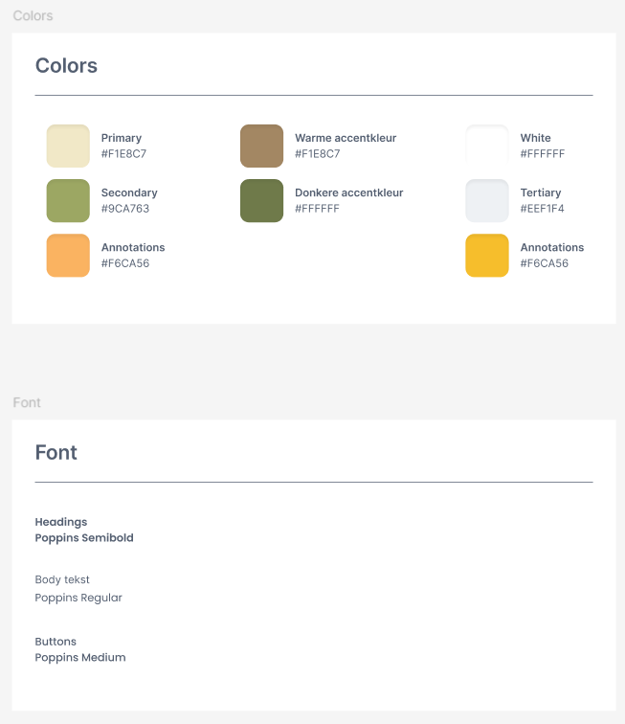

Media

Slide 4




Media

Slide 5
Media

Slide 6
Software

Slide 7
Software

Slide 8
Technology

Slide 9
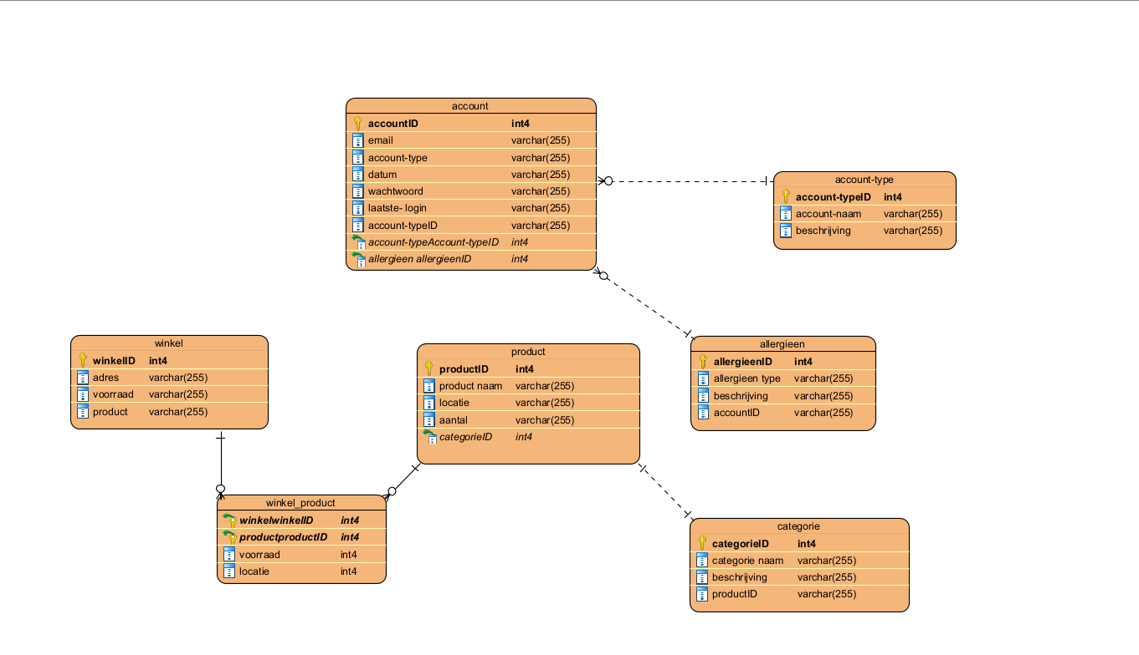
Business

Slide 10
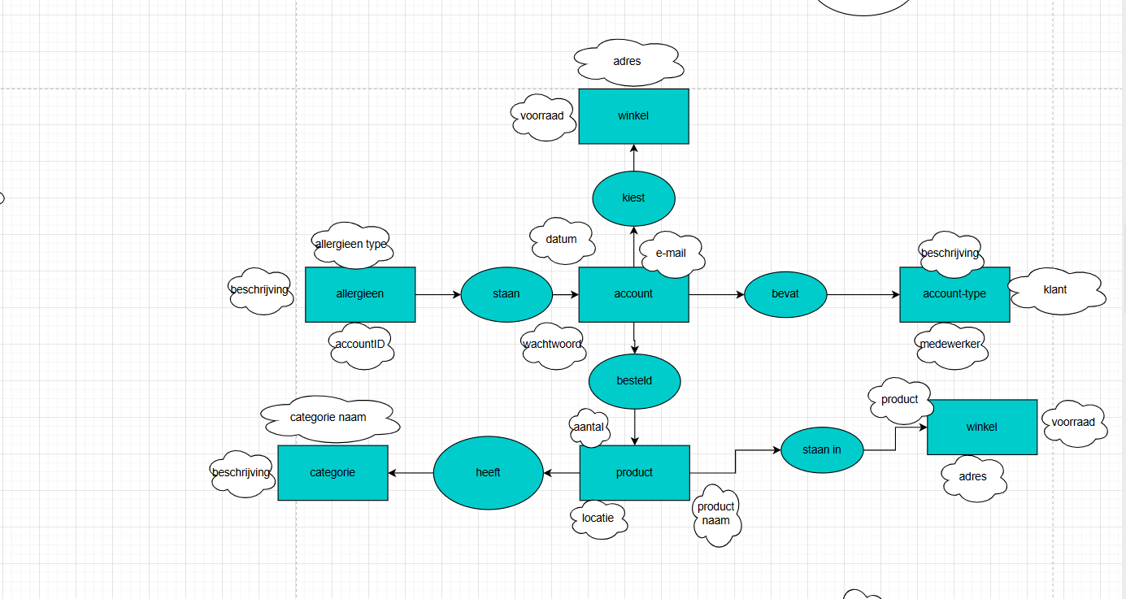
Business

Slide 11
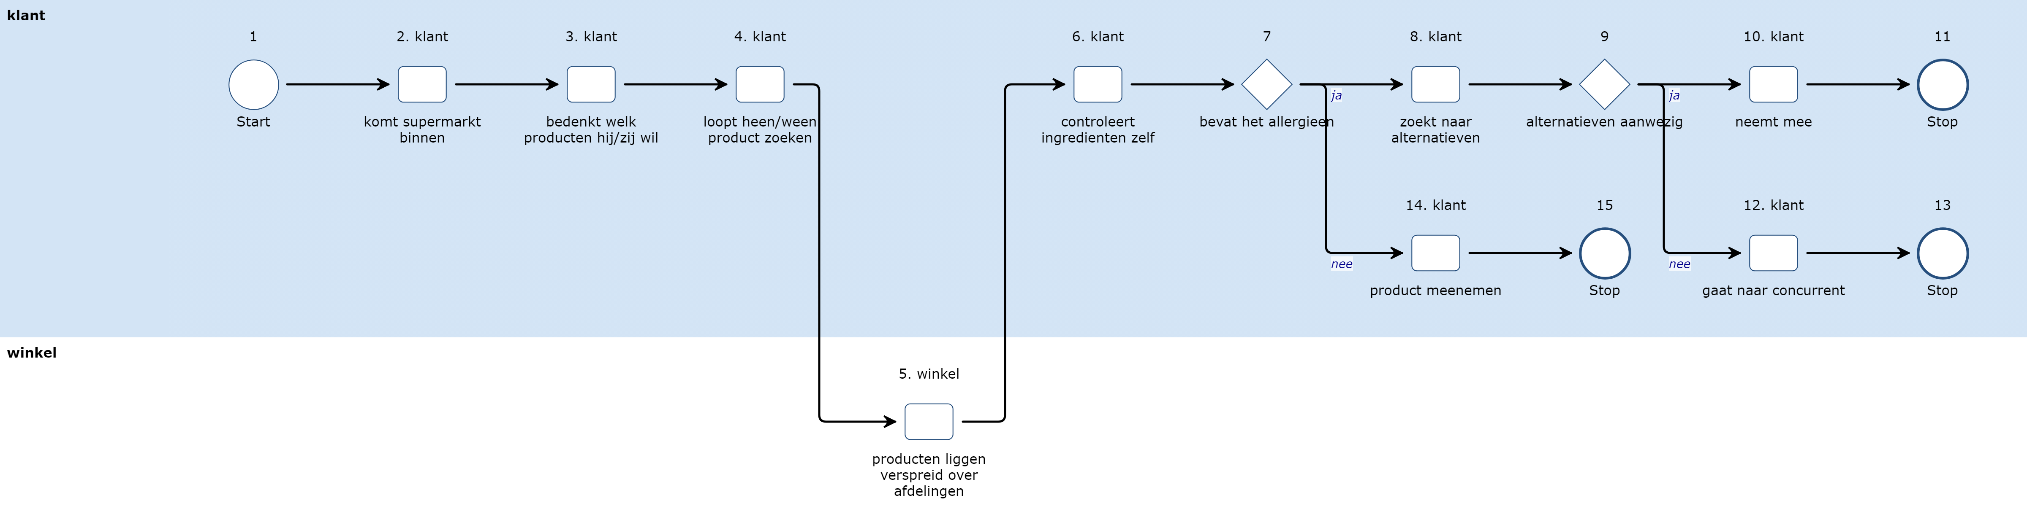
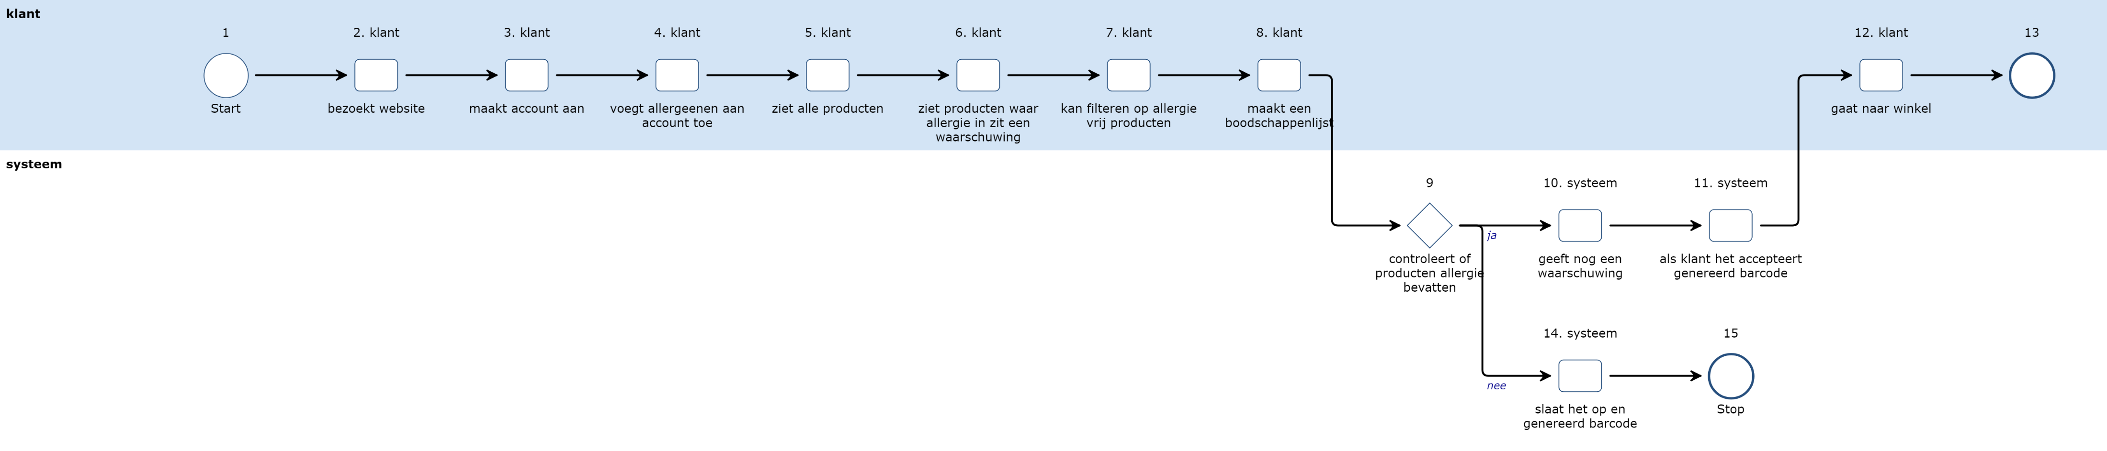
Business

Slide 12
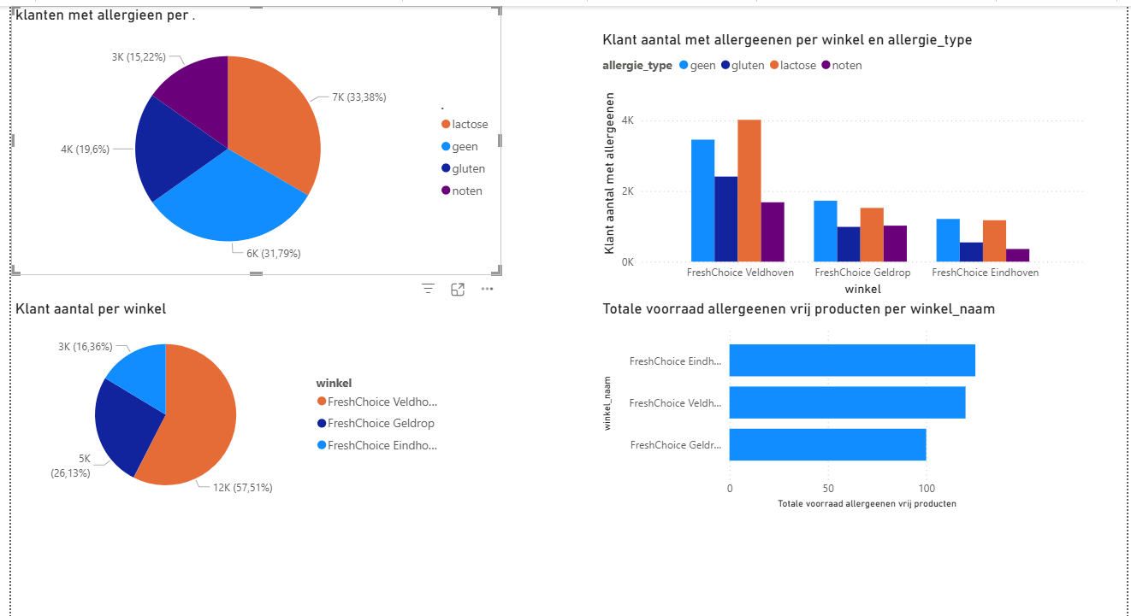
Business

Slide 13


